Slide 1
Group 11
Joe Wilson, Max Pugh,
Thomas Mclaren

Slide 2
Game Concept
The concept of the game will be a 2-player competitive mountain climbing game with the goal of reaching the top first.
The physics concept we will be using is motion and forces.

Slide 3
Game Mechanics
The two Player’s character will be connected by a climbing rope.
They both have the ability to move, jump, climb and have the ability to pull at the rope to pull the other player towards them.

Slide 4
Gameplay Components
2 Players
PC
We intend for a target audience of 13 – 30.
We plan for a maximum of 5 minutes per play through
The goal is to reach the top of the mountain first

Slide 5
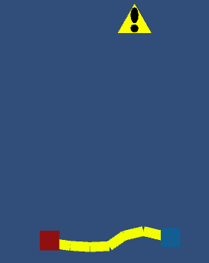
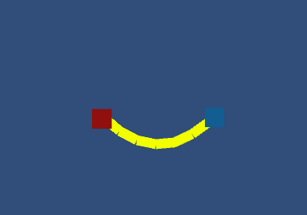



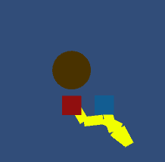


Game Mockup

Slide 6
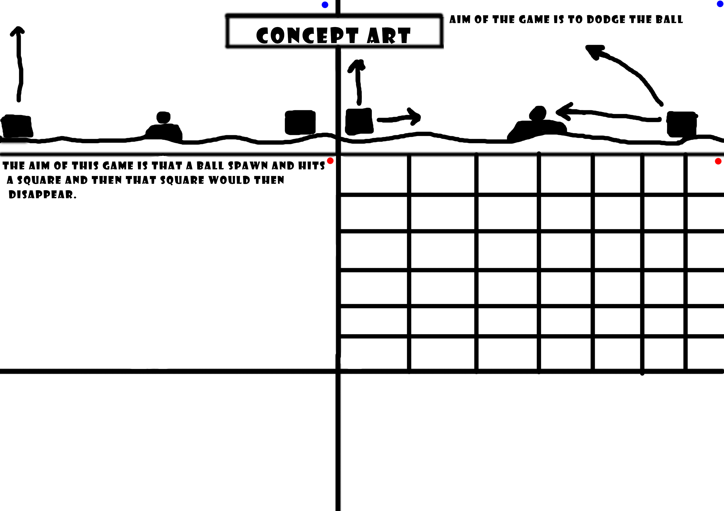
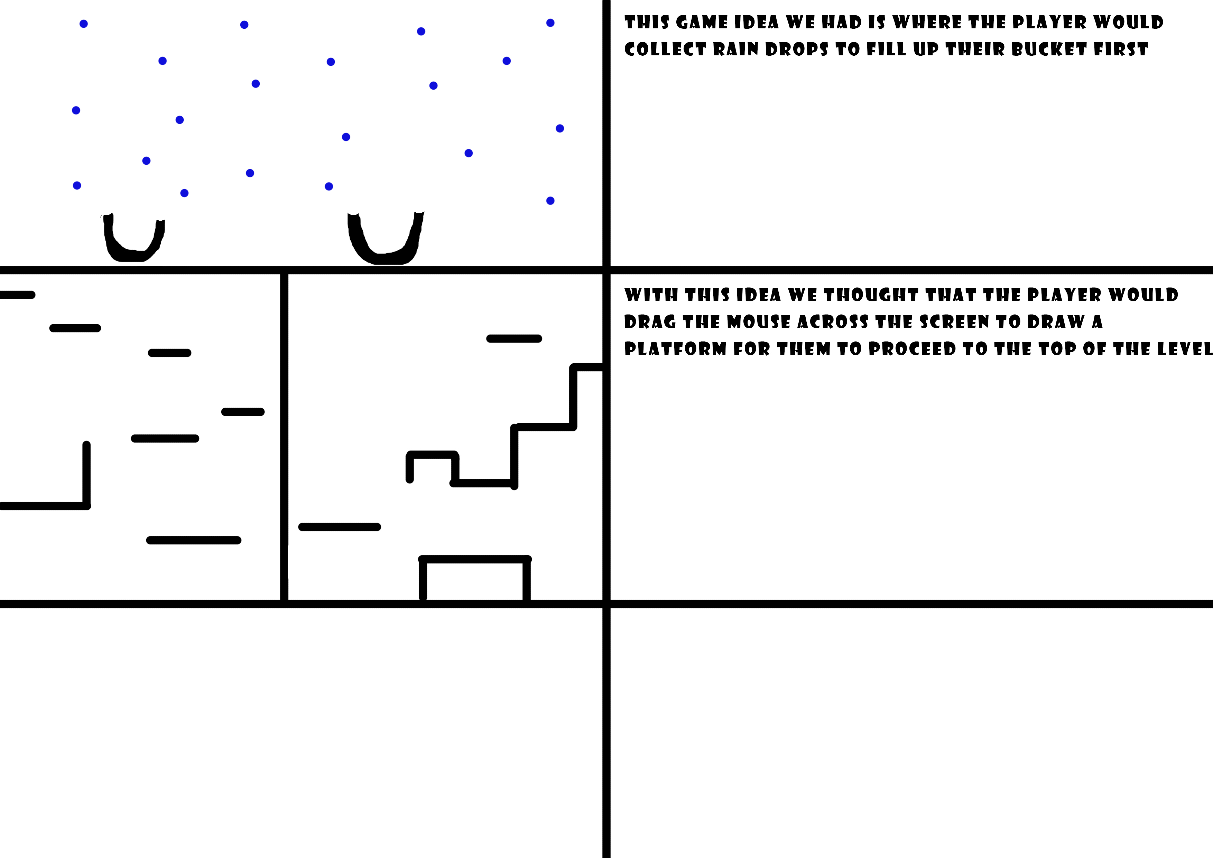
Other Ideas

Slide 7
Our Plan
By week two we plan to have working prototypes and have them play tested.

Slide 8
Questions?

